Slide 1
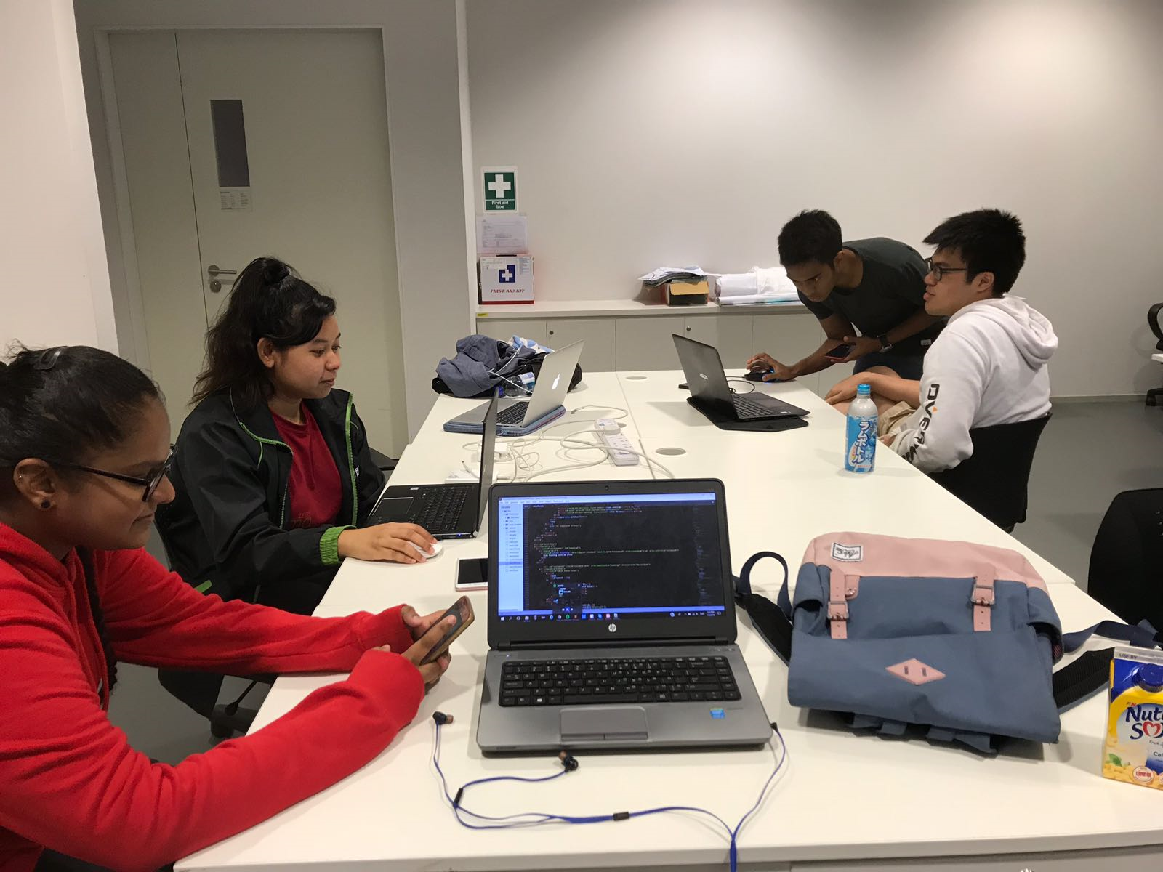
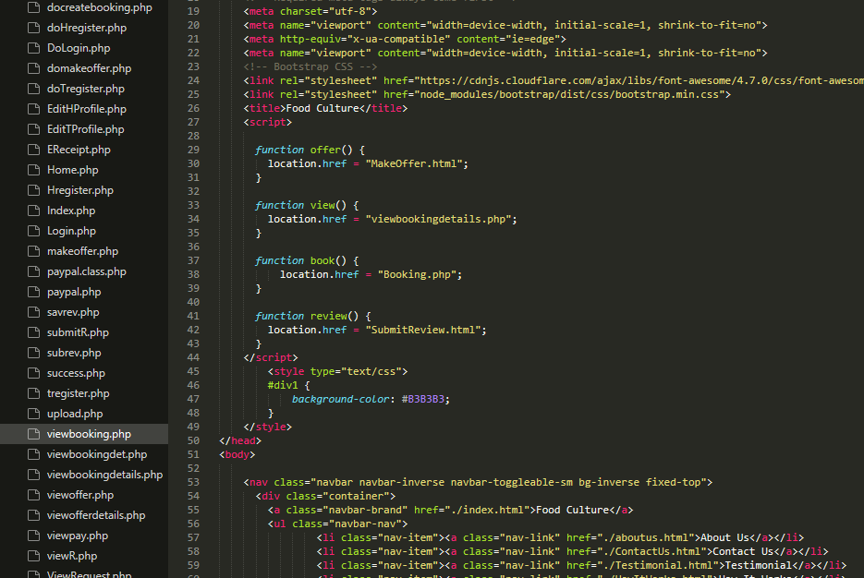
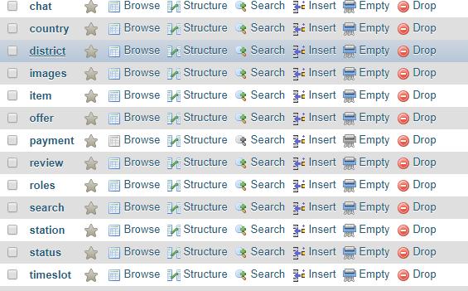
Food Culture
Project Overview
Problem: Tourists from all around the world wants to experience a cultural experience just by visiting the country. This was seen ineffective as without proper guide they find it very hard to get to know about the culture in Singapore. Tourist have to pay a little more extra for a tour guide to have that experience. Even so, the tour guide only brings them around to places but not indepth
Requirements: This project is being implemented through various languages such as HTML5, PHP, CSS, and Javascript. By using HTML5 and CSS, we are able to create our User Interface to make it look as attractive as we possibly could. PHP and Javascript were used in allowing us to code out the functions that help to run the application as the back-end. With all of these languages integrated together, we were able to design and create a functioning web application.
Solution: Food Culture web application allows people from different background and culture to experience the local culture of Singaporeans. This app is providing this service that is different from what is usually being implemented in this country; an example would be Airbnb. Instead of the guest staying in a host’s accommodation and explore the country by themselves, this app eliminates the hassle of the guest going around to get the feel of the culture in Singapore by allowing the guest to spend the day with the host themselves through a meal session. This create a more meaningful experience for both the guest and the host as through a meal session, they are able to communicate and create a bond that they can’t get if they were to go on a holiday by themselves.
Technologies: Raspberry Pi (IoT), PayPal (Payment external gateway), Face Recognition (JQuery), Amazon Cloud Computing Platform EC2, PHPMailer
Name 1: Nur Atikah
Name 2: Nazreen
Name 3: Syakir Mikhail
Name 4: Zhao Liang
Notes:
NOTES
Refer to write ups in ‘Past Projects for Reference’ Booklet for Project overview write ups - http://yoda.soi.rp.edu.sg/wiki/index.php/FYP_Wiki
ENGLISH - British Eg. organisation VS organization
Font: RP approved font - Arial family only.
Header: Arial Bold
Copy text: Arial regular or Arial Bold. Use Emphasis of our SOI orange in moderation.
Picture frame – Give a 4.5 or 6pt orange outline.

